Slide 1

CryptoCurrency Advisory/ Trading Bot
Mehrdad Akhlaghi
Cindy Chen
Sargun Singh
Tito K

Slide 2

Project Proposal
Scope: For this project, our group has decided to develop a Cryptocurrency Advisory Bot, which will use machine learning technology models such as:
Neural Network
We have chosen neural networks as we believe
it has higher capacity and output
they are versatile
it can improve accuracy though multiple training and testing process.
detect complex nonlinear relationships between dependent and independent variables, ability to detect all possible interactions between predictor variables, and the availability of multiple training
Supported Vector Machine
Logistic Regression
Ballinger Bands
This advisory bot will indicate the following signals:
Buy,
Sell
Hold

Slide 3
Project Proposal
Indicators:
Finta python library will be used to generate signals along with usage of SMA.
Simple Moving day Averages (SMA) (Long and Short)
SMA is a great option for our indicator as it uses both long and short term moving average, which can be very helpful in understanding a cryptocurrency trajectory, as well entry and exit.
Relative Strength Index (RSI)
Fear and greed index (This is through an API. The F&G index can provide a better visualization on human/market emotions. When paired with SMA, we can get much better understanding when to sell, buy or hold. )
Neural Networks-Deep Learning (for back testing)
Bollinger Bands
It helps determine whether prices are high or low on a relative basis. Bollinger Bands are separated into 2 bands, upper and lower bands with SMA being utilized together.

Slide 4

Litecoin Trading Bot
Litecoin ranks in the Top 15 largest cryptocurrencies in terms of market capitalization
Designed to produce four times as many blocks as Bitcoin
Data from Yahoo Finance API

Slide 5
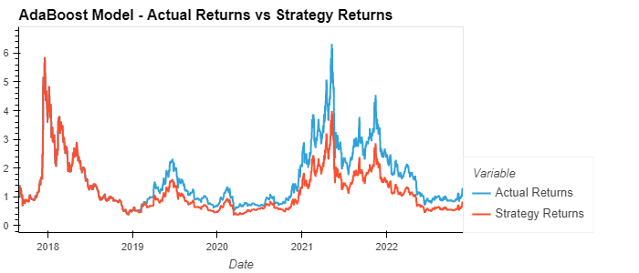
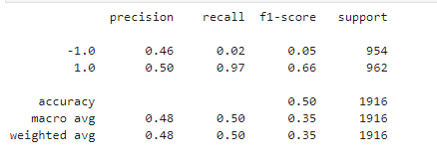
Litecoin: Adaptive Boosting Machine Learning
Cumulative Actual Returns vs Predicted Return
Classification Report :
1: Positive actual return
-1: Negative actual return

Slide 6
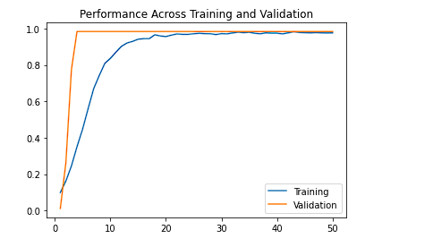
Litecoin: Neural Network for trading type
Pre-set for trading advisory bot
Use Kares Sequential Model
Fit the model with 120 epochs running and testing accuracy and loss
Forecast trading type decision: buy, sell, hold
8 years data used from 2014 to 2022

Slide 7
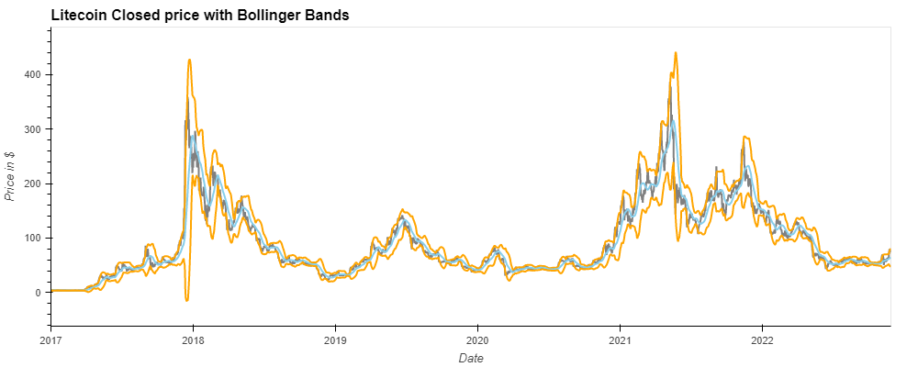
Litecoin: Bollinger Bands Indicator
Orange: Upper and Lower Bands
Grey: Closed Price
Blue: Middle Band

Slide 8
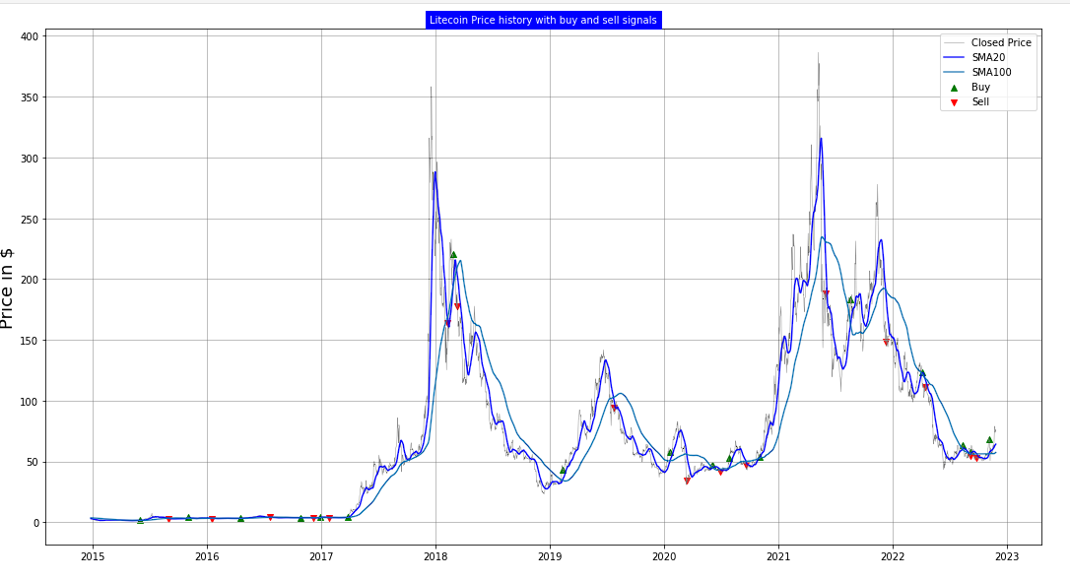
Litecoin: 7 years price history with trading

Slide 9

Ripple Trading Bot
XRP or Ripple is is a real-time gross settlement system, currency exchange and remittance network created by US based Ripple Labs Inc. in 2012.
Designed to provide secure payment options to members of an online community via a global network
Data from Yahoo Finance API

Slide 10
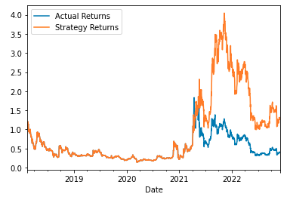
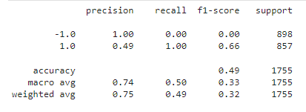
Ripple: Adaptive Boosting Machine Learning
Cumulative Actual Returns vs Predicted Return
Classification Report :
1: Positive actual return
-1: Negative actual return

Slide 11
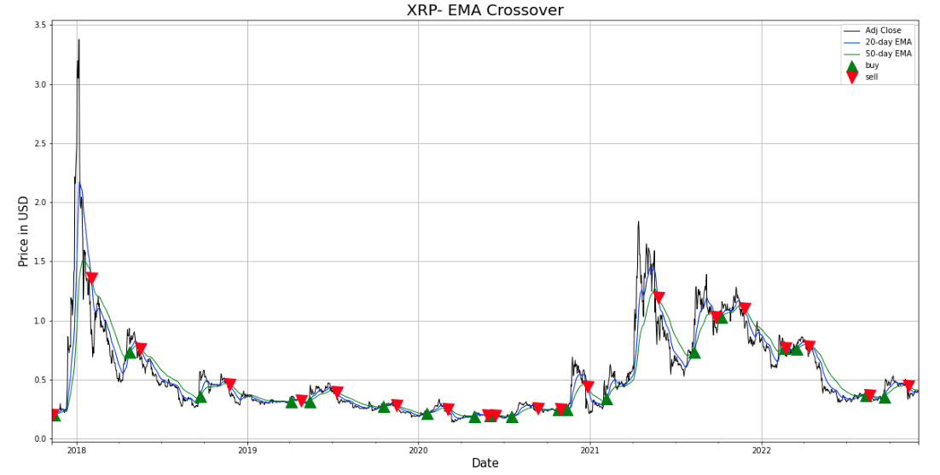
Ripple: EMA 20 Days vs 100 Days
Grey: Adjusted Closed Price Blue: EMA 20 Days Green: EMA 100 Days

Slide 12

Multi Crypto Trading Bot
Bitcoin,
Litecoin,
XRP
and Doge Coin.

Slide 13
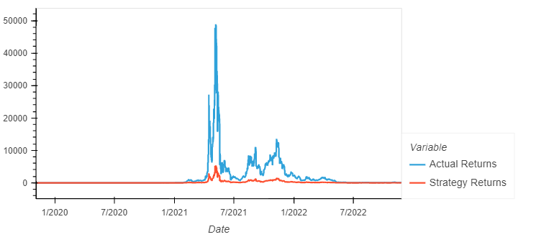
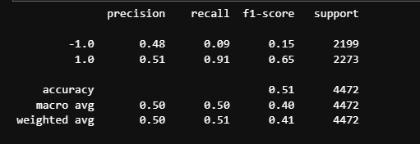
SVM Machine learning Classifier Results
Actual vs model strategy rerturns
SVM Classification Report

Slide 14
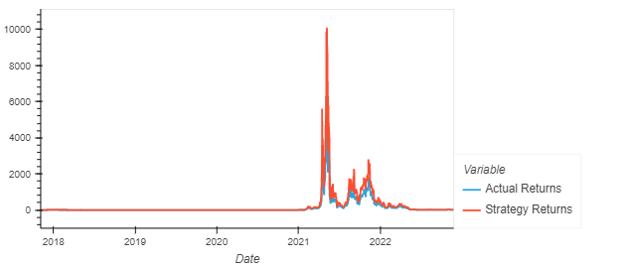
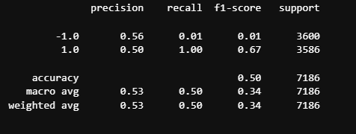
Logistic Regression Machine learning Model
Actual vs strategy Return plot
Logistic regression results

Slide 15
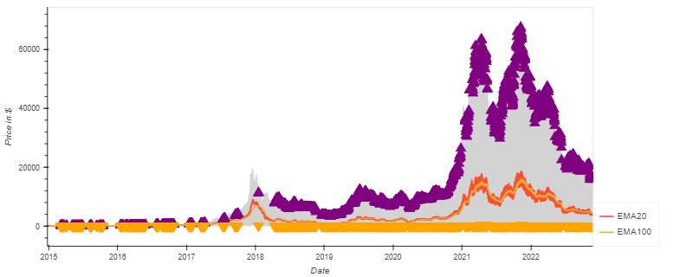
Exponential Moving Average EMA 20 vs. EMA 100

Slide 16

Parabolic SAR
A solid trading indicator which has three main functions:
Highlights current trend or price direction.
Provides potential entry signals
Provides potential exit signals

Slide 17
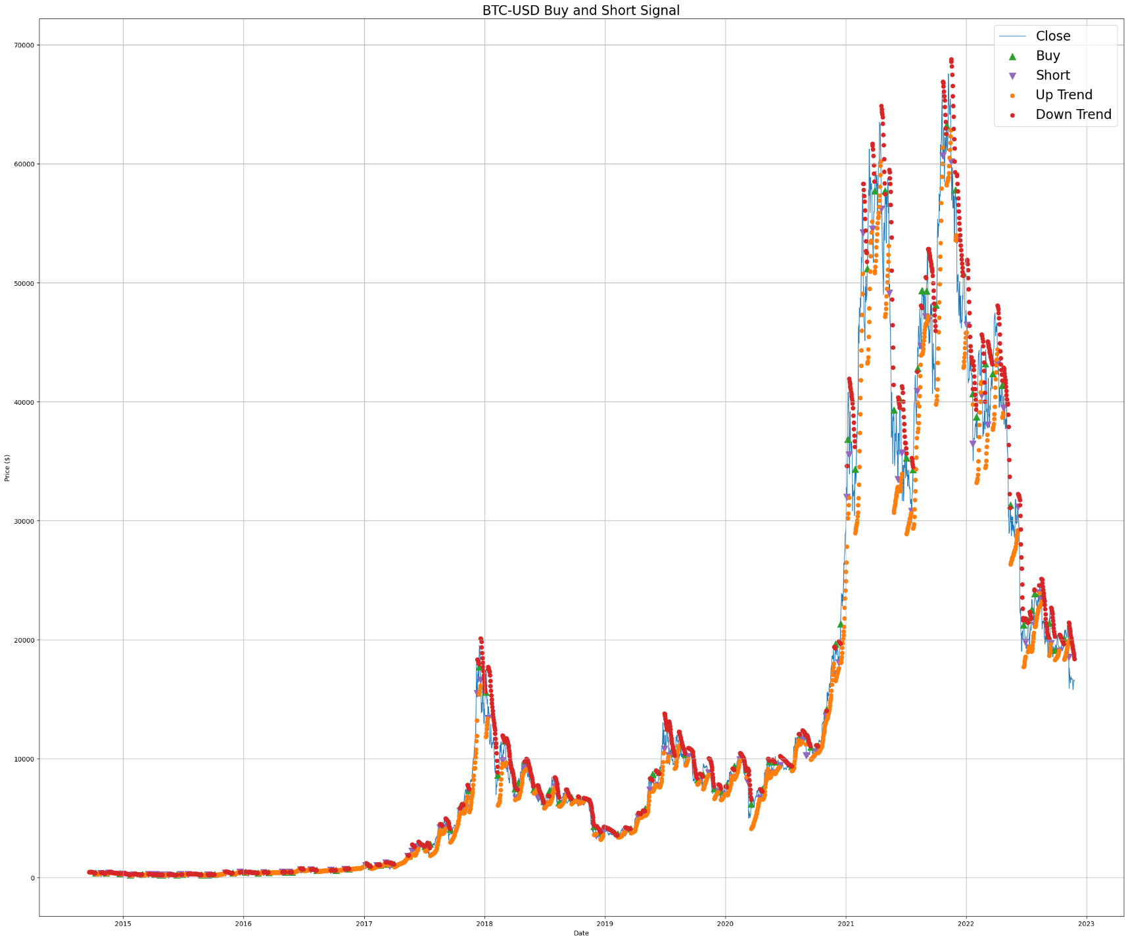
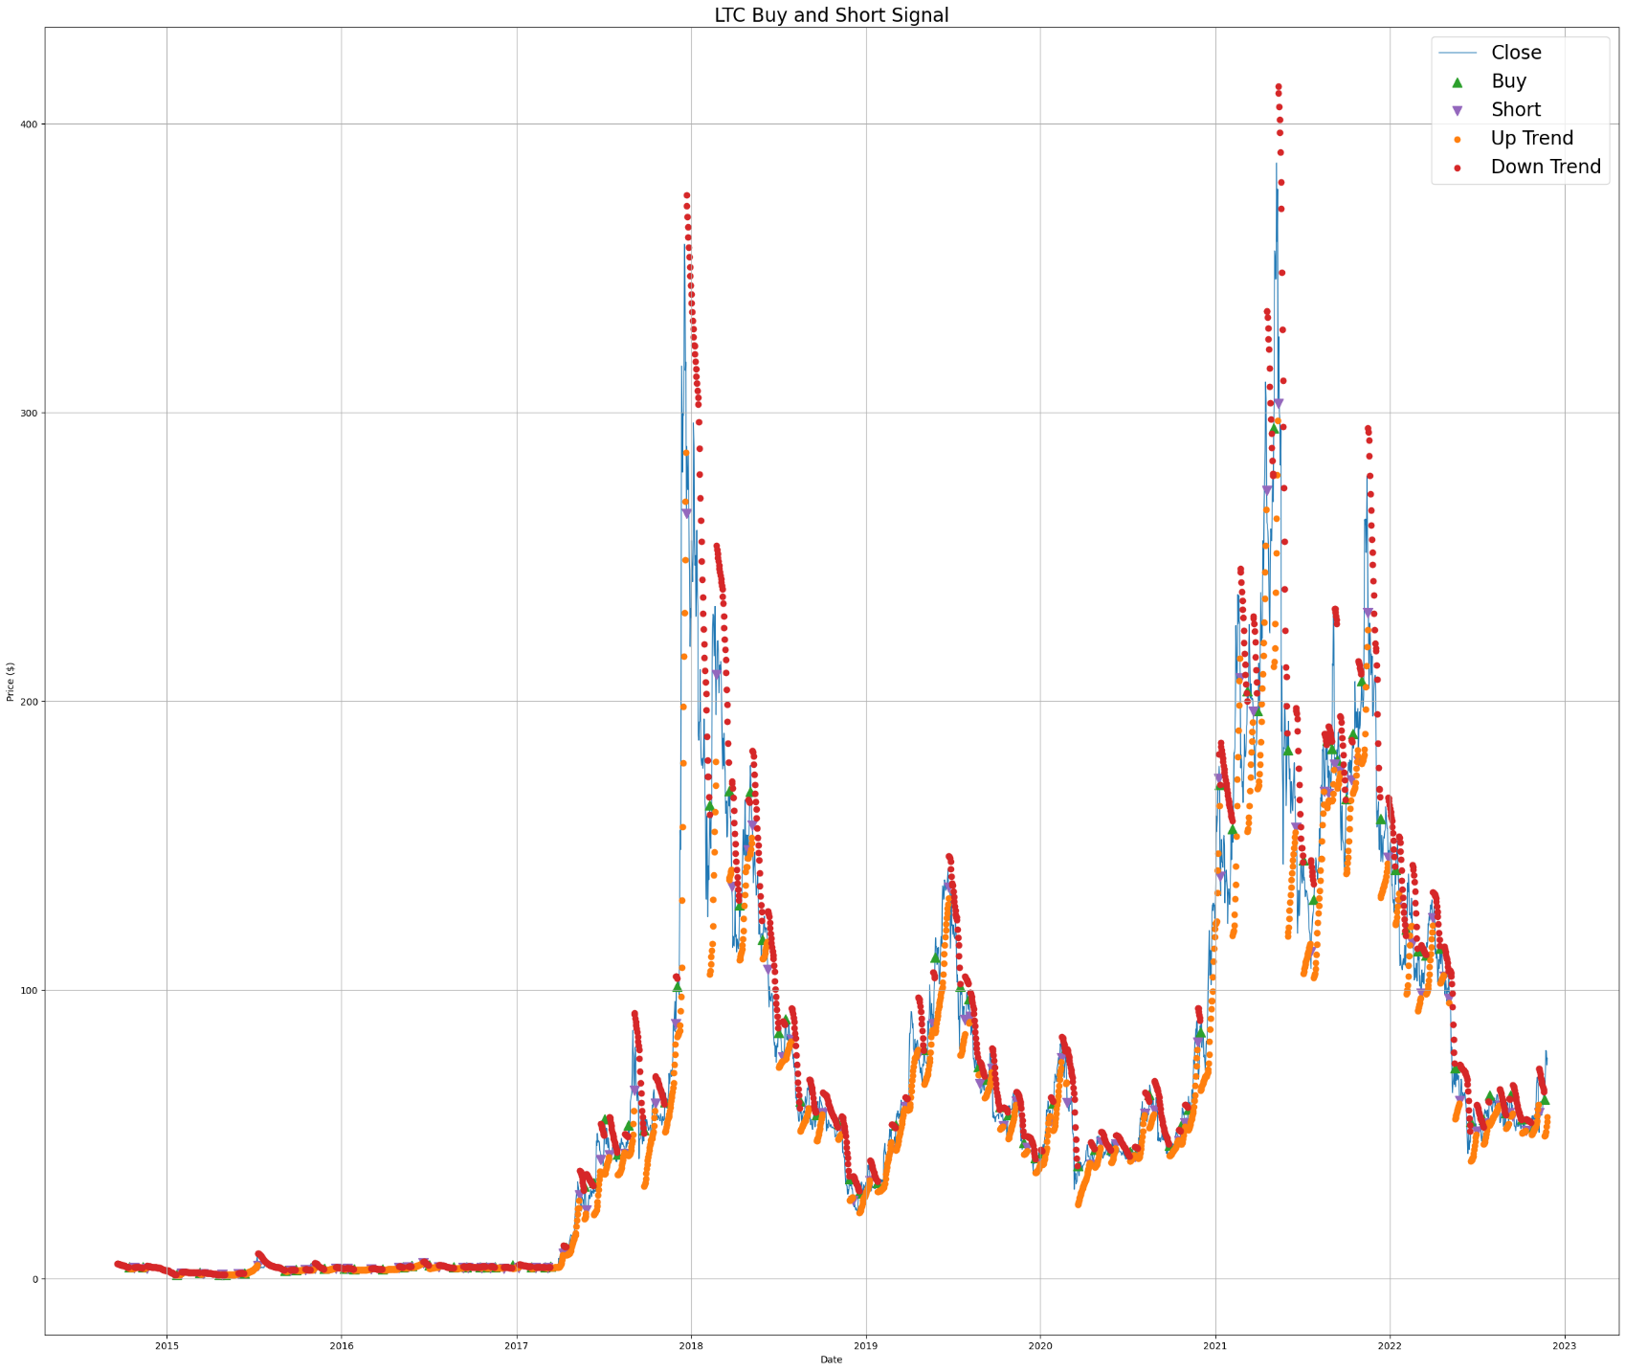
PARABOLIC SAR COMPONENTS FOR CALCULATION:
EP: EXTREME POINTS ON TREND
AF: ACCELERATION RATE
UPTREND :
PSAR=Prior PSAR + Prior AF(Prior EP – Prior PSAR)
DOWN TREN
PSAR=Prior PSAR – Prior AF(prior PSAR – Prior EP),
Where:
EP = Highest High for an uptrend and lowest low for a downtrend. Updated each time a new EP is reached.
AF= Default of 0.02, increasing by 0.02 each time a new EP is reached, with a maximum of 0.20

Slide 18
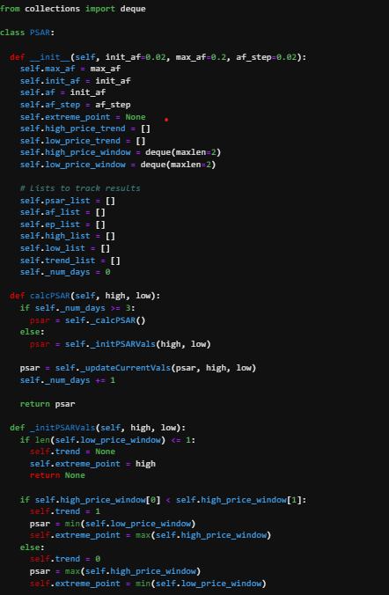
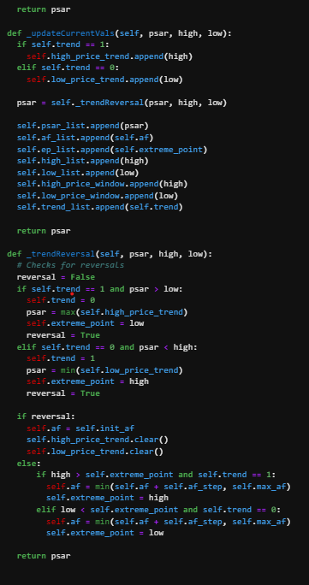
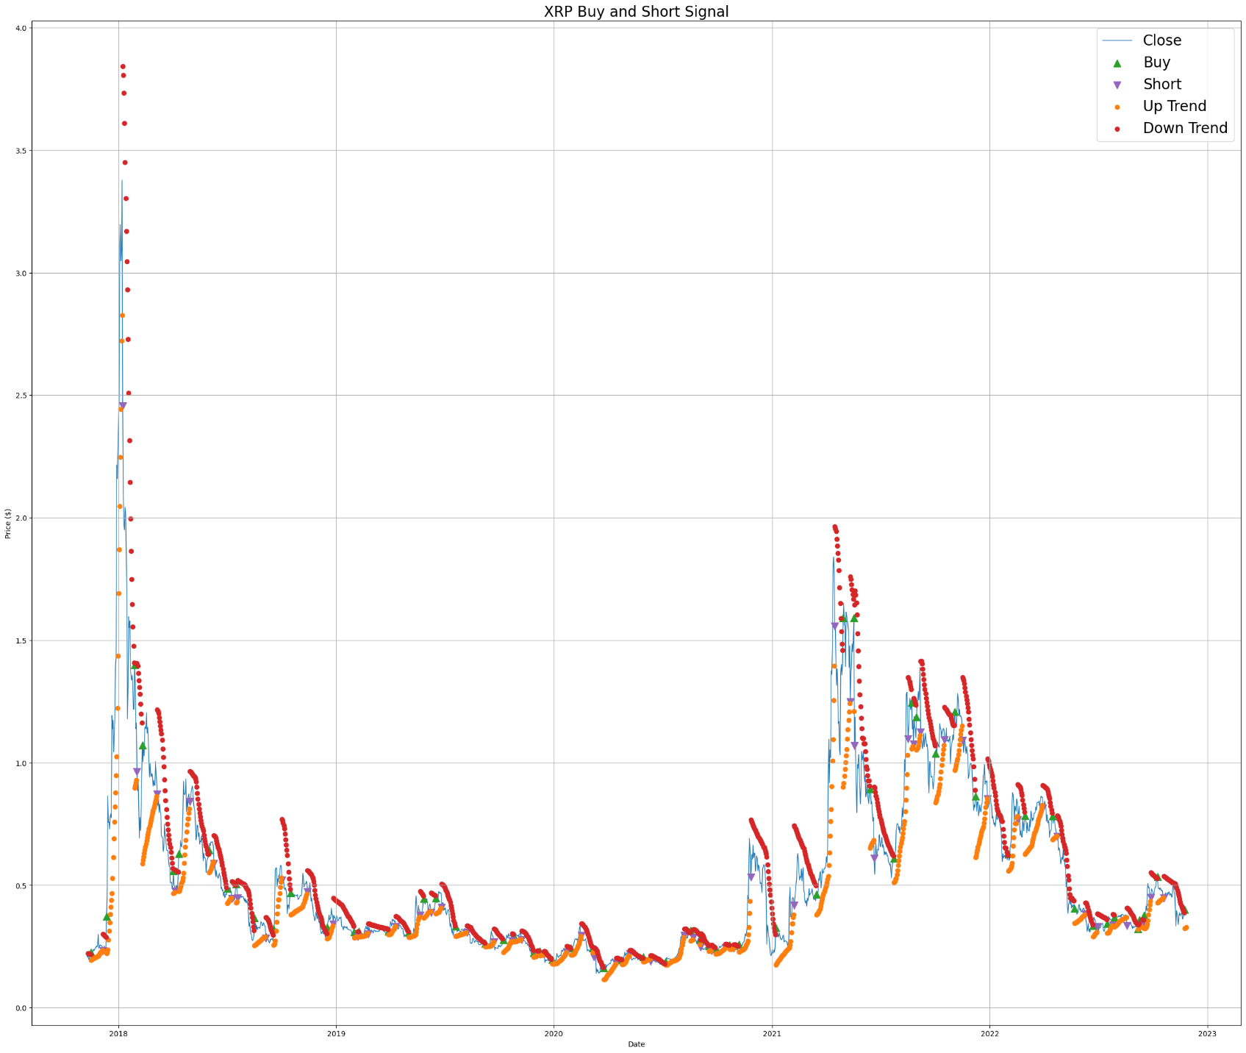
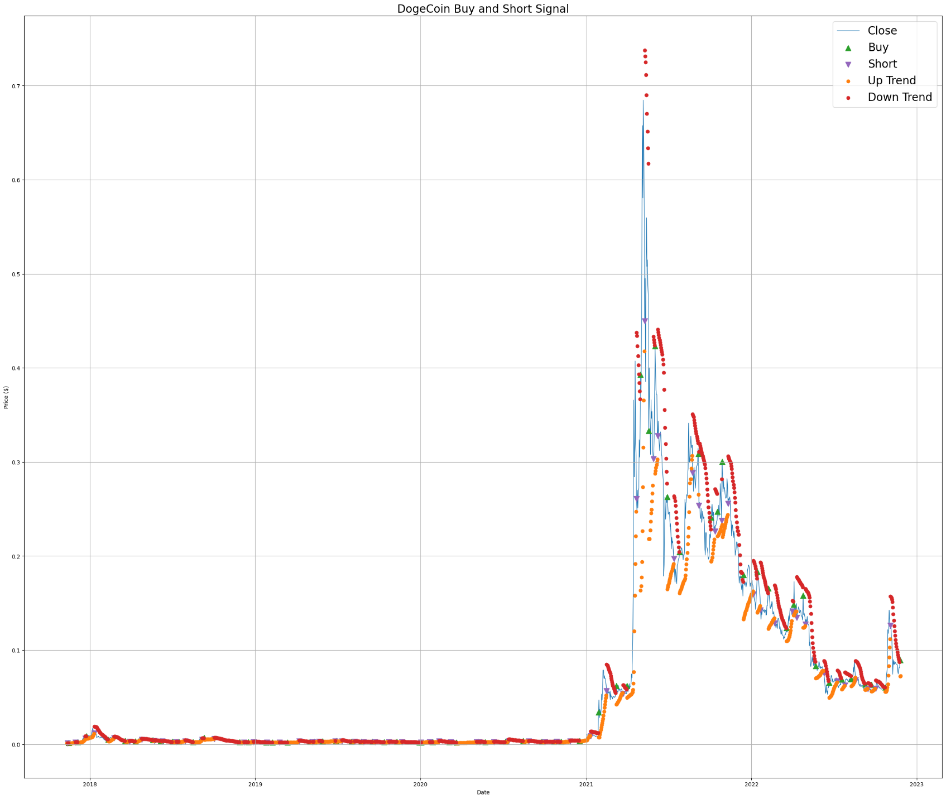

Slide 21


Thank You
Questions

